Slide 1
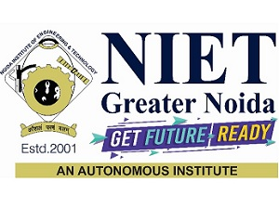
Noida Institute of Engineering and Technology, Greater Noida
Deep Learning with Keras
Workshop on
Programming for Data Analytics
From 29 Jan 2024 to 10 Feb 2024
Dr. Kumod Kumar Gupta
Assistant Professor
Department of AI

Slide 2

Topic Objectives
Day1
Keras syntax basics
Keras regression program
Exercise
Day 2
1. Keras classification cancer data
2. GAN Program
3. Variational Encoder Program

Slide 3
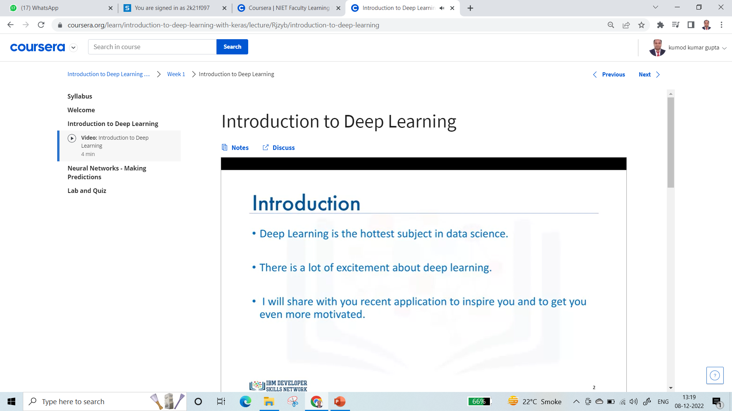
Introduction to Deep Learning

Slide 4

Introduction to Deep Learning

Slide 5
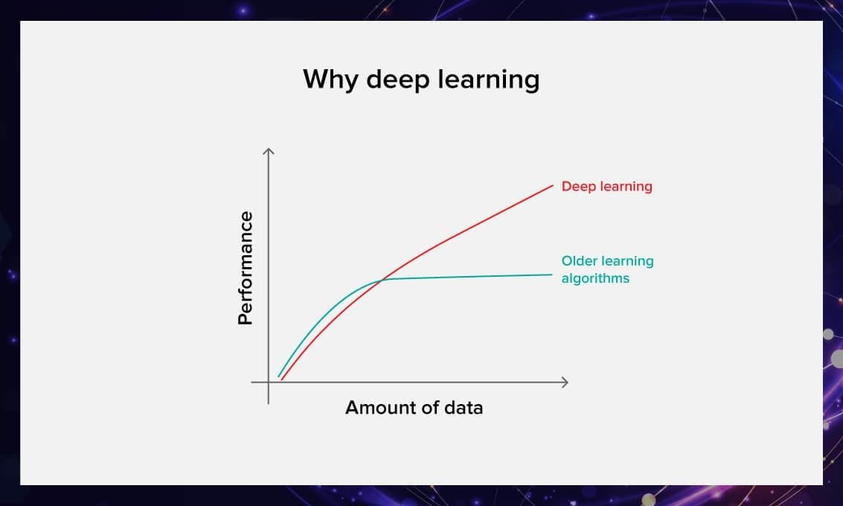
Introduction to Deep Learning
Different Types of Network

Slide 6
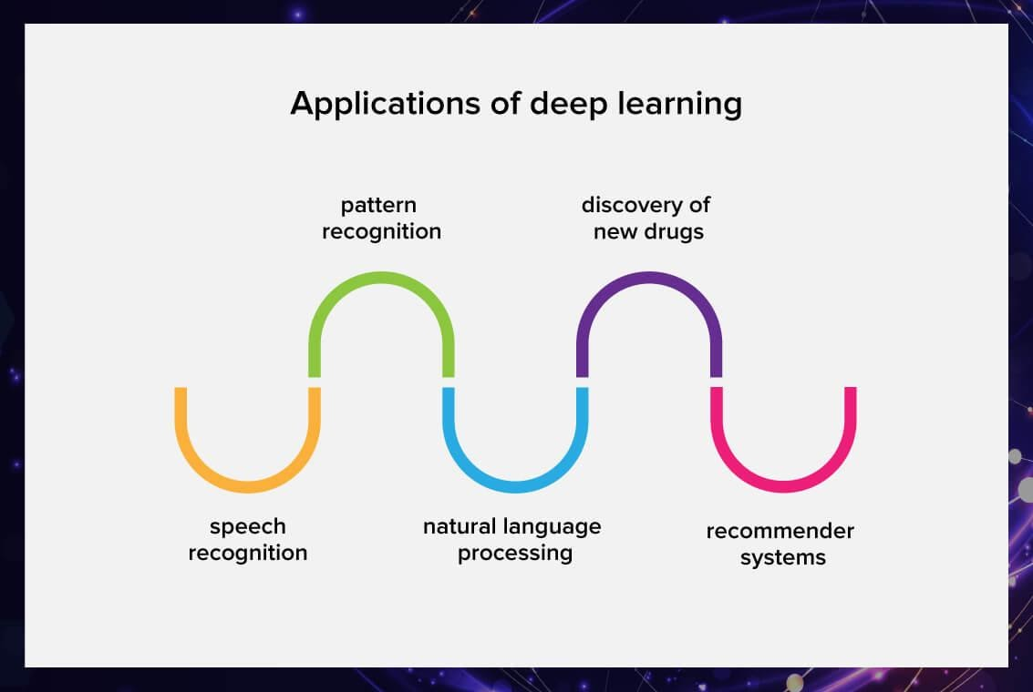
Introduction to Deep Learning

Slide 7
Introduction to Deep Learning
Speech recognition: Some of the familiar software like Apple’s Siri, Google’s Alexa, and Microsoft Cortana are based on deep neural networks.
Pattern recognition: Pattern recognition is very useful in medical and life sciences. These algorithms can help radiologists to find tumor cells in the CT scans or even help them to understand the mechanism behind protein folding. Furthermore, other areas such as finance can also use pattern recognition systems to detect fraudulent transactions.
NLP: Natural language processing or NLP is one of the hot topics in deep learning these days. Modern architectures like the transformers have revolutionized and improved machine translation and language modeling. One of such models is GPT3 by Ope; it has almost reached general intelligence in all NLP tasks.
Recommender systems: Recommender systems are on almost every social media platform these days from Instagram to YouTube and Netflix. These companies use a recommendation system to recommend shows, videos, posts, and stories based on

Slide 8
Introduction to Deep Learning
Finally, here are some of the real-life use cases of deep learning.
Healthcare
Medical image analysis: Medical images such as CT scans, MRI, and X-rays can sometimes be difficult to interpret; this mostly happens when the anomalies like the tumor get saturated in the background.
Deep learning algorithms can help to find anomalies that are unseen to the naked eye. Algorithms like the Hierarchical Probabilistic U-Net by Google’s DeepMind is one such example that is capable of finding tumor cells in medical images. Such algorithms are found to be a great tool for radiologists and doctors.
Surgical robotics: There are times when a critical patient is unable to find a surgeon; in such dire and life-threatening conditions surgical robots can come to the rescue. Such robots have a superhuman ability to repeat exact motions like that of a trained surgeon.

Slide 9
Introduction to Deep Learning
TensorFlow and Keras
TensorFlow is an Open- source deep learning library developed by Google, with TF2.0 being official released in late 2019.
TensorFlow has a large ecosystem of related components, including libraries like Tensorboard, Development and Production APIs, and support for various programming languages.
Keras is a high- level python library that can use a variety of deep learning libraries underneath, such as: TensorFlow, CNTK, or Theano.
TensorFlow 1.x had a complex python class system for building models, and due to the huge popularity of Keras, when TF2.0 was released, TF adopted Keras as the official API for TF.
While Keras still also remains as a separate library from TensorFlow, it can also now officially be imported through TF, so there is now need to additionally install it.

Slide 10
Introduction to Deep Learning
TensorFlow and Keras
The Keras API is easy to use and builds models by simply adding layers on top of each other through simple calls.
Let’s now explore the basics of the Keras API for TensorFlow.

Slide 11
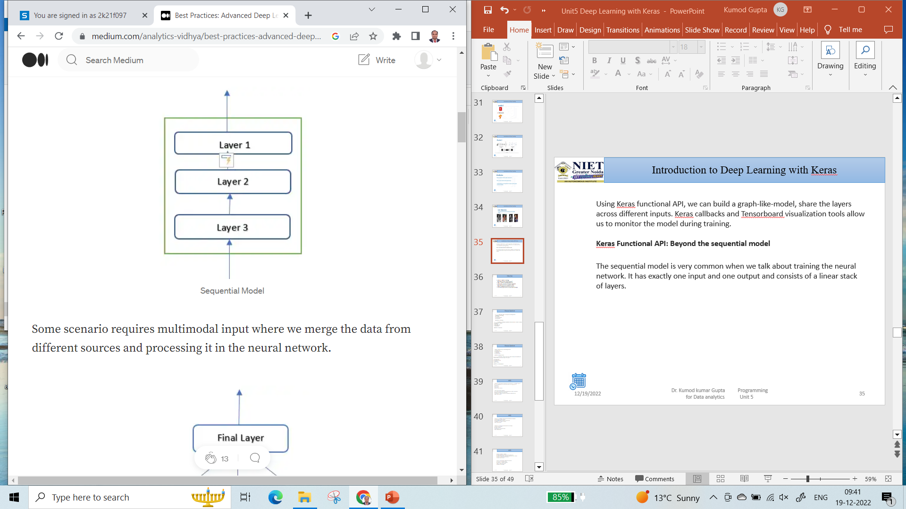
Introduction to Deep Learning with Keras
Using Keras functional API,
We can build a graph-like-model,
Share the layers across different inputs.
Keras callbacks and Tensorboard visualization tools allow us to monitor the model during training.
Keras Functional API: Beyond the sequential model
The sequential model is very common when we talk about training the neural network. It has exactly one input and one output and consists of a linear stack of layers.

Slide 12
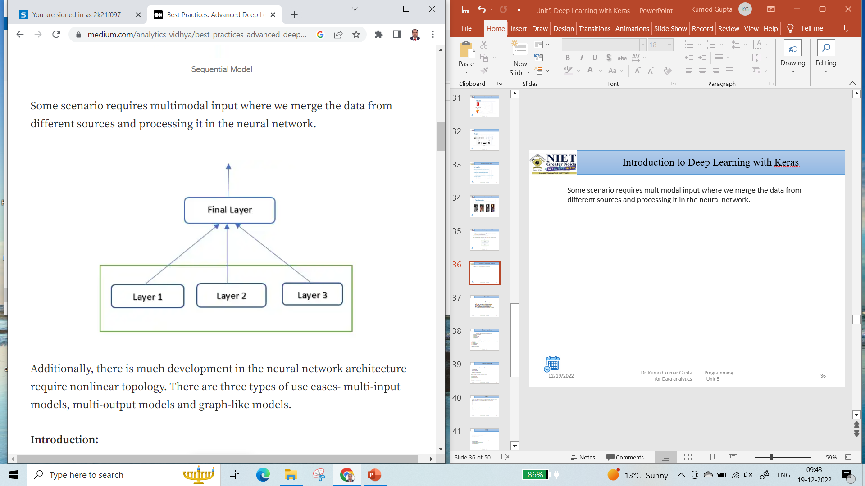
Introduction to Deep Learning with Keras
Some scenario requires multimodal input where we merge the data from different sources and processing it in the neural network.
Additionally, there is much development in the neural network architecture require nonlinear topology.
There are three types of use cases- multi-input models, multi-output models and graph-like models.

Slide 13
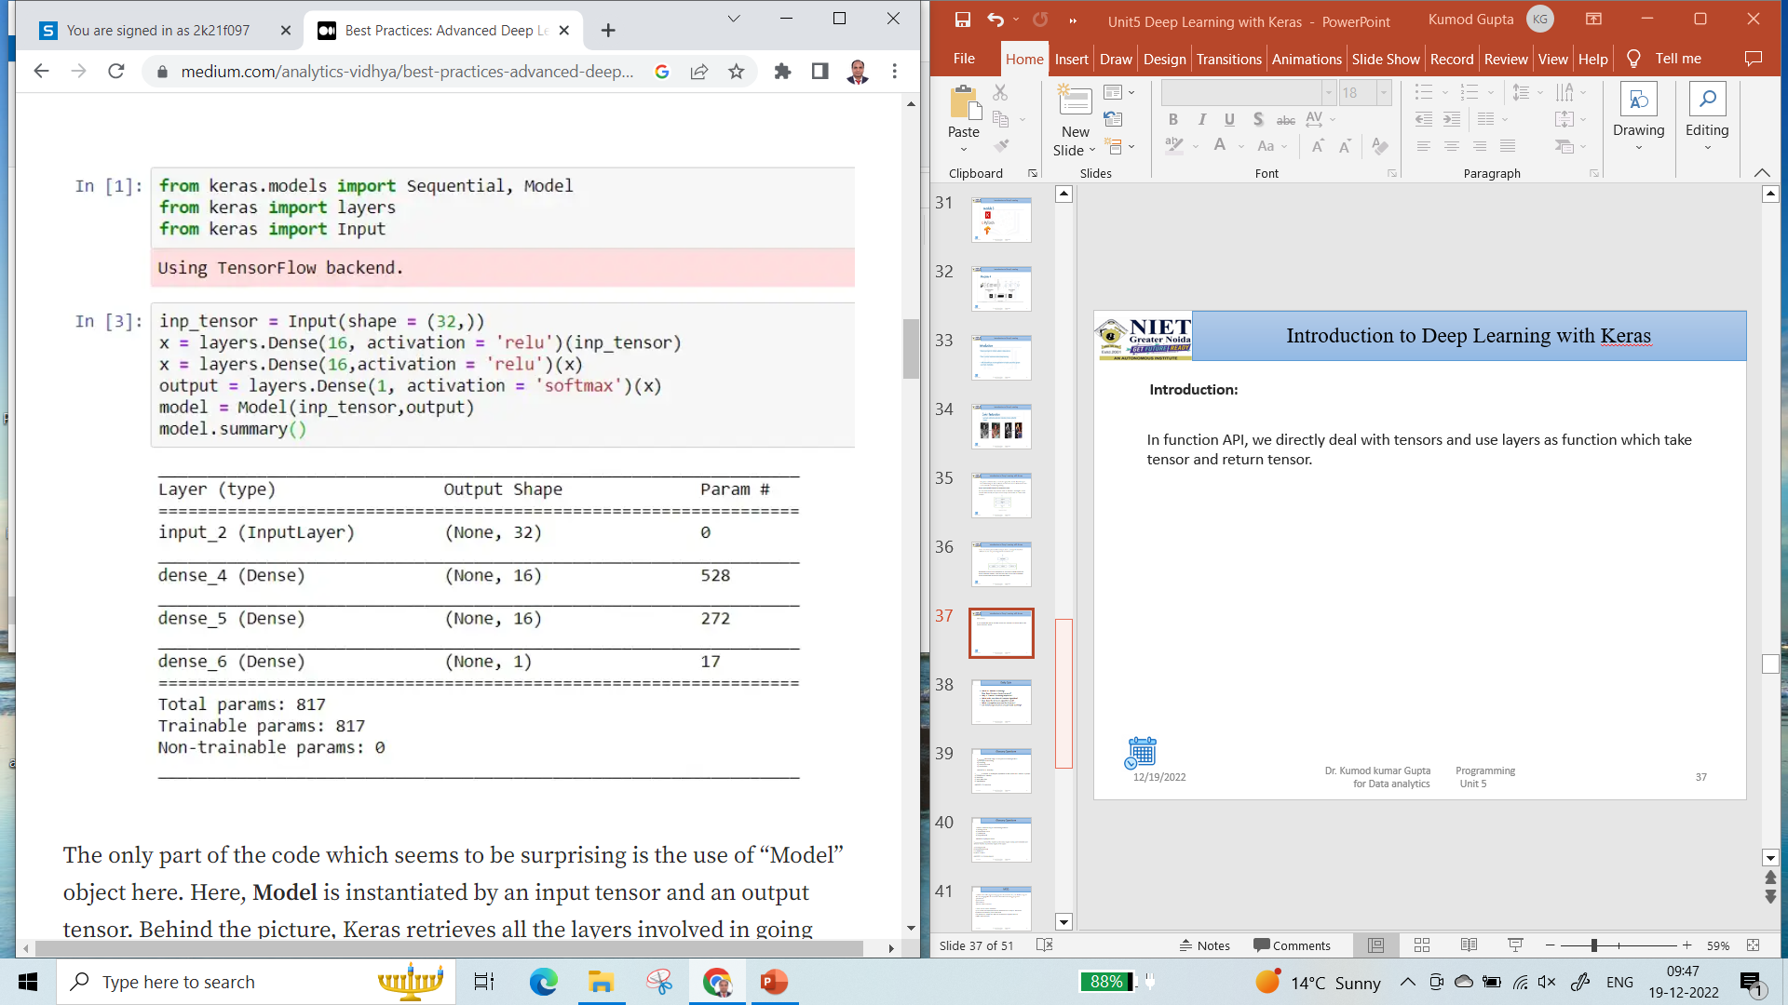
Introduction to Deep Learning with Keras
Introduction:
In function API, we directly deal with tensors and use layers as function which take tensor and return tensor.

Slide 14
Introduction to Deep Learning with Keras
The only part of the code which seems to be surprising is the use of “Model” object here. Here, Model is instantiated by an input tensor and an output tensor.
Behind the picture, Keras retrieves all the layers involved in going from input tensor to output tensor, bringing them together into a graph-like data structure.

Slide 15
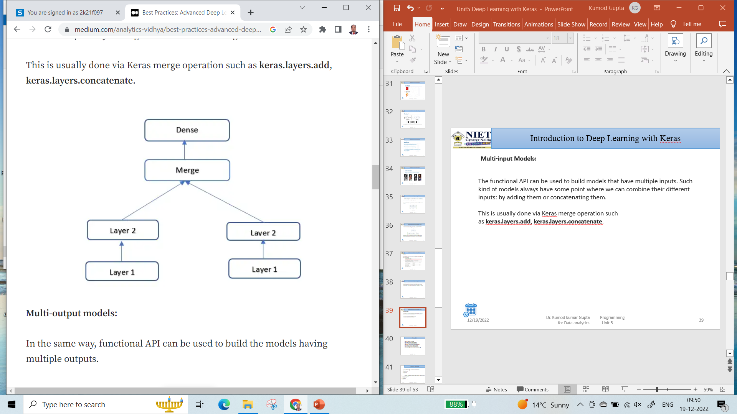
Introduction to Deep Learning with Keras
Multi-input Models:
The functional API can be used to build models that have multiple inputs. Such kind of models always have some point where we can combine their different inputs: by adding them or concatenating them.
This is usually done via Keras merge operation such as keras.layers.add, keras.layers.concatenate.

Slide 16
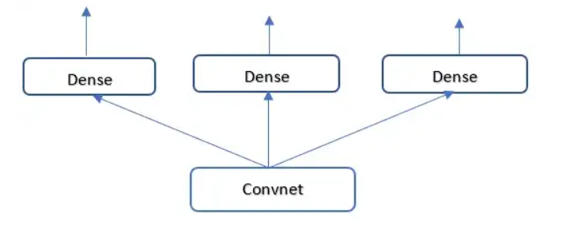
Introduction to Deep Learning with Keras
Multi-output models:
In the same way, functional API can be used to build the models having multiple outputs.

Slide 17
Introduction to Deep Learning with Keras
Importantly, training such a model requires the ability to specify different loss function for different heads of the network.
For one instance it might be regression and for another, it could be binary classification required different training procedures.
But because gradient descent requires us to minimize a scalar, we must combine these losses into a single value in order to train the model. The simplest way to combine different losses is to sum them all.
In Keras, we can use either a list or a dictionary of losses in compile to different objects for different outputs: the resulting loss values are summed into a global loss, which is minimized during training.

Slide 18
Introduction to Deep Learning with Keras
Note that very imbalanced loss contribution will cause the model representations to be optimized preferentially for the task with the largest individual loss, at the expense of another task.
To remedy this, we can assign the different levels of importance to the loss value in their contribution to the final loss.

Slide 19
Introduction to Deep Learning with Keras
Directed Acyclic Graph of Layers:
In functional API, we can also implement network with complex internal topology. Neural Networks in Keras can be arbitrary directed acyclic graphs of layers. The qualifiers acyclic is important: these graphs can’t have cycles.
It is impossible for a tensor x to become the input of another layer that generated x. The only processing loops that are allowed (i.e recurrent connections) are those internal to recurrent layers.

Slide 20
Introduction to Deep Learning with Keras
Several common neural-network components are implemented as graphs:
1. Inception Modules
2. Residual connections.
Inception Modules:
Inception model was developed by Christian Szegedy in 2013–14. It contains small independents modules split into parallel branches.
The most basic form of an Inception module had three or four branches starting with 1x1 convolution, followed by 3x3 convolution and ending with the concatenating of the resulting features.
This setup helps the network separately learn spatial features and channel-wise features, which is more efficient than learning them jointly.

Slide 21
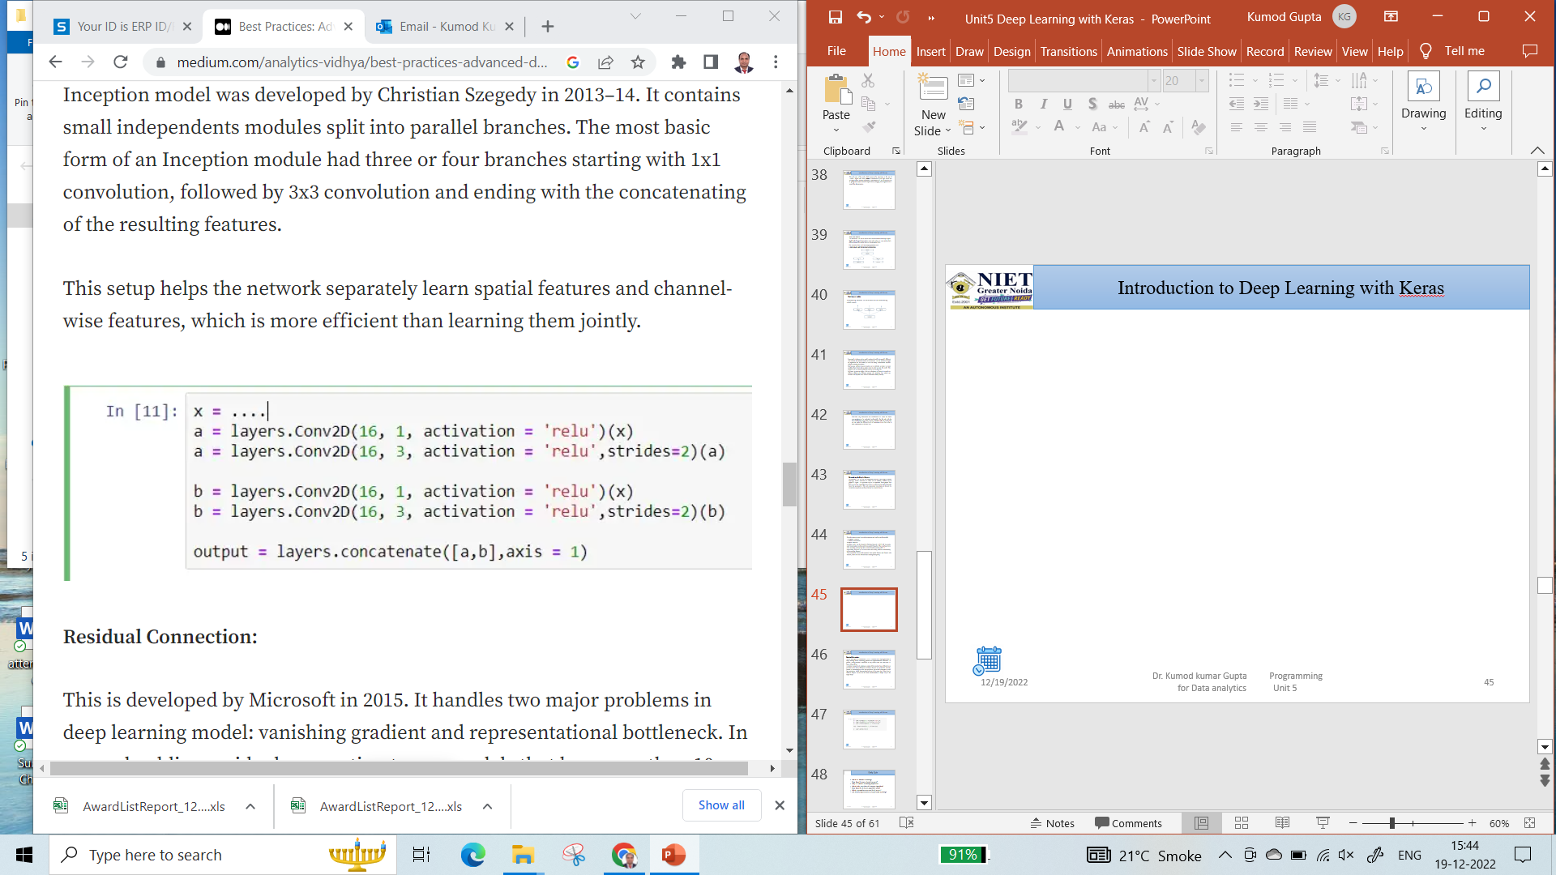
Introduction to Deep Learning with Keras

Slide 22
Introduction to Deep Learning with Keras
Residual Connection:
This is developed by Microsoft in 2015. It handles two major problems in deep learning model: vanishing gradient and representational bottleneck.
In general, adding residual connection to any models that has more than 10 layers is beneficial.
A residual connection is making an output of the previous layer effectively as an input to later layer, effectively creating a shortcut in q sequential network.
Instead of concatenating to the later activation, the earlier is summed up with later activation, which assumes that both are of the same size. If they are in different shapes, we can use the linear transformation to shape it up in the target shape.

Slide 23
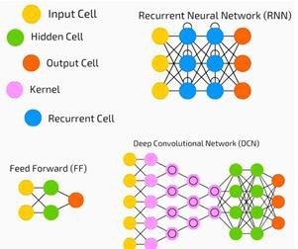
Deep Neural Network
A deep neural network (DNN) is an ANN with multiple hidden layers between the input and output layers. Similar to shallow ANNs, DNNs can model complex non-linear relationships.
The main purpose of a neural network is to receive a set of inputs, perform progressively complex calculations on them, and give output to solve real world problems like classification.
We restrict ourselves to feed forward neural networks.
We have an input, an output, and a flow of sequential data in a deep network.

Slide 24
Deep Neural Network
Neural networks are widely used in supervised learning and reinforcement learning problems. These networks are based on a set of layers connected to each other.
In deep learning, the number of hidden layers, mostly non-linear, can be large; say about 1000 layers.
DL models produce much better results than normal ML networks.
We mostly use the gradient descent method for optimizing the network and minimizing the loss function.
We can use the Imagenet, a repository of millions of digital images to classify a dataset into categories like cats and dogs.
DL nets are increasingly used for dynamic images apart from static ones and for time series and text analysis.

Slide 25
Deep Neural Network
Training the data sets forms an important part of Deep Learning models.
In addition, Backpropagation is the main algorithm in training DL models.
DL deals with training large neural networks with complex input output transformations.
One example of DL is the mapping of a photo to the name of the person(s) in photo as they do on social networks and describing a picture with a phrase is another recent application of DL.

Slide 26
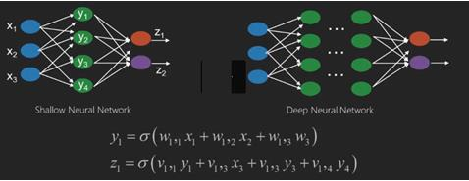
Deep Neural Network
Neural networks are functions that have inputs like x1,x2,x3…that are transformed to outputs like z1,z2,z3 and so on in two (shallow networks) or several intermediate operations also called layers (deep networks).
The weights and biases change from layer to layer. ‘w’ and ‘v’ are the weights or synapses of layers of the neural networks.
The best use case of deep learning is the supervised learning problem. Here, we have large set of data inputs with a desired set of outputs.

Slide 27
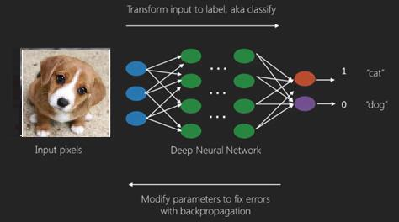
Deep Neural Network

Slide 28
Deep Neural Network
Here we apply back propagation algorithm to get correct output prediction.
The most basic data set of deep learning is the MNIST, a dataset of handwritten digits.
We can train deep a Convolutional Neural Network with Keras to classify images of handwritten digits from this dataset.
The firing or activation of a neural net classifier produces a score.
For example, to classify patients as sick and healthy, we consider parameters such as height, weight and body temperature, blood pressure etc.
A high score means patient is sick and a low score means he is healthy.
Each node in output and hidden layers has its own classifiers. The input layer takes inputs and passes on its scores to the next hidden layer for further activation and this goes on till the output is reached.
This progress from input to output from left to right in the forward direction is called forward propagation.

Slide 29
Deep Neural Network
Credit assignment path (CAP) in a neural network is the series of transformations starting from the input to the output.
CAPs elaborate probable causal connections between the input and the output.
CAP depth for a given feed forward neural network or the CAP depth is the number of hidden layers plus one as the output layer is included.
For recurrent neural networks, where a signal may propagate through a layer several times, the CAP depth can be potentially limitless.

Slide 30
Deep Neural Network
LeNet
AlexNet
VGGNet
GoogLeNet
ResNet
ZFNet

Slide 31
Auto-Encoders
Autoencoders are neural network architectures that are intended for the compression and reconstruction of data.
It consists of an encoder and a decoder;
These networks are learning a simple representation of the input data. Reconstruction loss ensures a close match of output with input, which is the basis for understanding more advanced architectures such as VAEs.
The encoder aims to learn efficient data encoding from the dataset and pass it into a bottleneck architecture.
The other part of the autoencoder is a decoder that uses latent space in the bottleneck layer to regenerate images similar to the dataset. These results backpropagate the neural network in the form of the loss function.

Slide 32
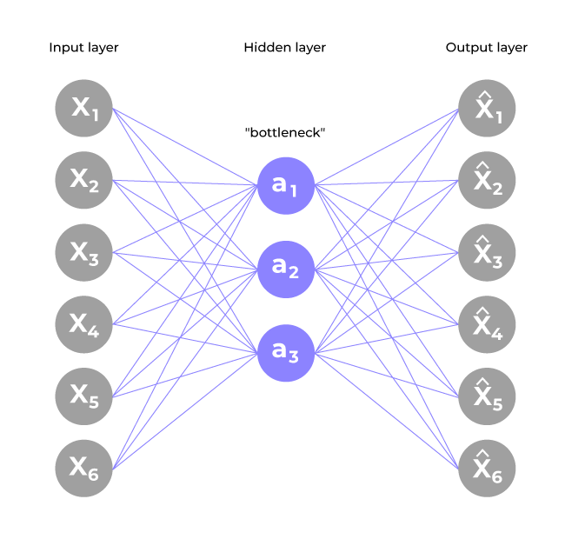
ML/Auto-Encoders
The typical architecture of an Auto-encoder resembles a bottleneck.

Slide 33
ML/Auto-Encoders
Encoder
Input layer take raw input data
The hidden layers progressively reduce the dimensionality of the input, capturing important features and patterns. These layer compose the encoder.
The bottleneck layer (latent space) is the final hidden layer, where the dimensionality is significantly reduced. This layer represents the compressed encoding of the input data.
Decoder
The bottleneck layer takes the encoded representation and expands it back to the dimensionality of the original input.
The hidden layers progressively increase the dimensionality and aim to reconstruct the original input.
The output layer produces the reconstructed output, which ideally should be as close as possible to the input data.

Slide 34

Auto-Encoders

Slide 35
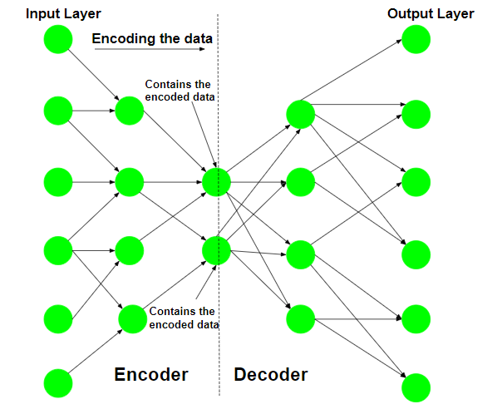
Auto-Encoders
Step 1: Encoding the input data The Auto-encoder first tries to encode the data using the initialized weights and biases.

Slide 36
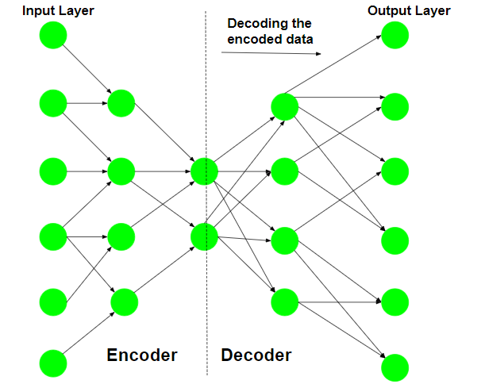
Auto-Encoders
Step 2: Decoding the input data The Auto-encoder tries to reconstruct the original input from the encoded data to test the reliability of the encoding.

Slide 37
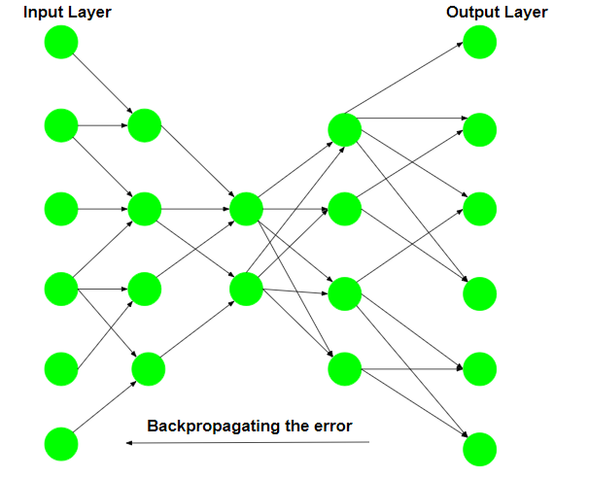
Auto-Encoders
Step 3: Backpropagating the error After the reconstruction, the loss function is computed to determine the reliability of the encoding. The error generated is backpropagated.

Slide 38
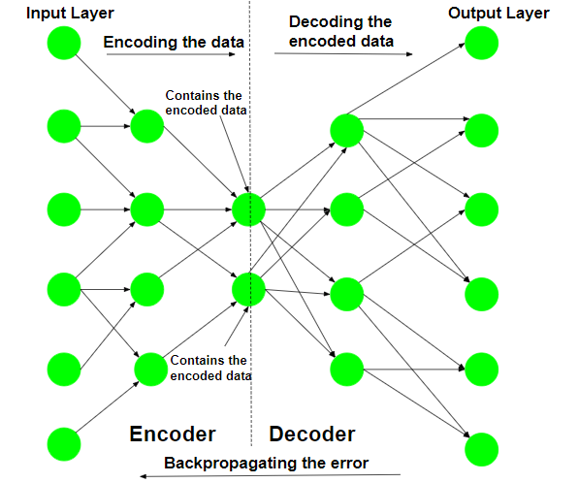
Auto-Encoders
The above-described training process is reiterated several times until an acceptable level of reconstruction is reached.

Slide 39
Auto-Encoders
After the training process, only the encoder part of the Auto-encoder is retained to encode a similar type of data used in the training process. The different ways to constrain the network are:-

Slide 40
Variational AutoEncoders
Variational autoencoder was proposed in 2013 by Knigma and Welling at Google and Qualcomm.
A variational autoencoder (VAE) provides a probabilistic manner for describing an observation in latent space.
Variational Autoencoders (VAEs) are generative models explicitly designed to capture the underlying probability distribution of a given dataset and generate novel samples.
Thus, rather than building an encoder that outputs a single value to describe each latent state attribute, we’ll formulate our encoder to describe a probability distribution for each latent attribute.
It has many applications such as data compression, synthetic data creation etc.

Slide 41
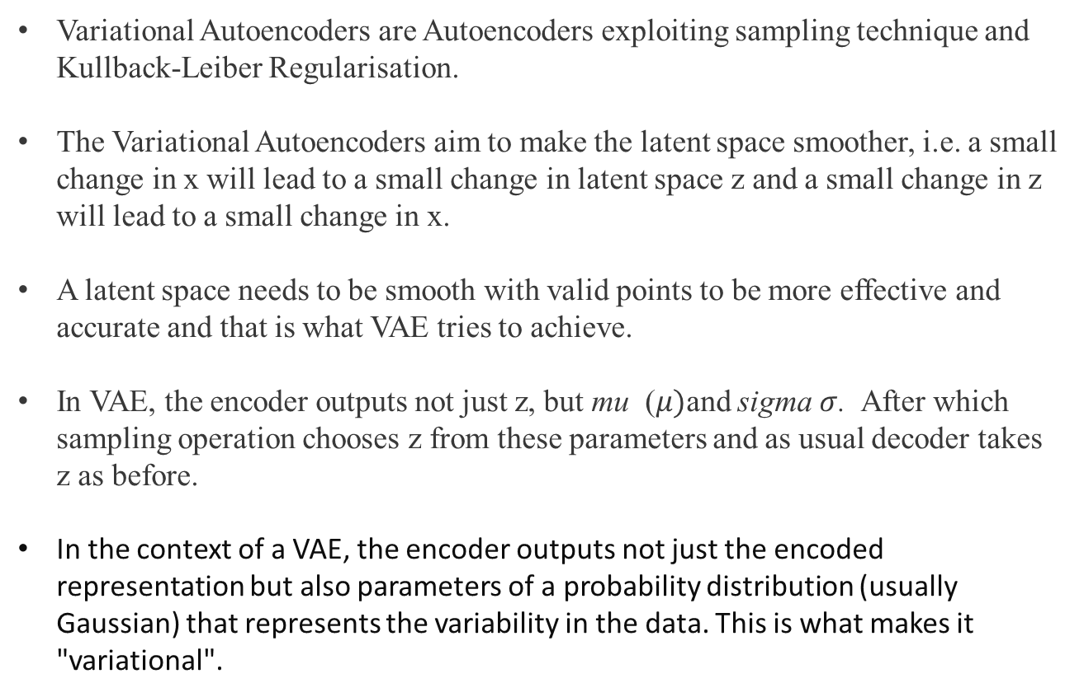
Variational AutoEncoders
Variational Autoencoders are Autoencoders exploiting sampling technique and Kullback-Leiber Regularisation.
The Variational Autoencoders aim to make the latent space smoother, i.e. a small change in x will lead to a small change in latent space z and a small change in z will lead to a small change in x.
A latent space needs to be smooth with valid points to be more effective and accurate and that is what VAE tries to achieve.
In VAE, the encoder outputs not just z, but mu ($μ)$and sigma $σ$. After which sampling operation chooses z from these parameters and as usual decoder takes z as before.
In the context of a VAE, the encoder outputs not just the encoded representation but also parameters of a probability distribution (usually Gaussian) that represents the variability in the data. This is what makes it "variational".

Slide 42
Variational AutoEncoders
They utilize an architecture that comprises an encoder-decoder structure.
The encoder transforms input data into a latent form, and the decoder aims to reconstruct the original data based on this latent representation.
The VAE is programmed to minimize the dissimilarity between the original and reconstructed data, enabling it to comprehend the underlying data distribution and generate new samples that conform to the same distribution.
One notable advantage of VAEs is their ability to generate new data samples resembling the training data. Because the VAE’s latent space is continuous, the decoder can generate new data points that seamlessly interpolate among the training data points. VAEs find applications in various domains like density estimation and text generation.

Slide 43
Variational AutoEncoders
Variational autoencoder is different from autoencoder in a way such that it provides a statistic manner for describing the samples of the dataset in latent space.
Therefore, in variational autoencoder, the encoder outputs a probability distribution in the bottleneck layer instead of a single output value.
Various neural network topologies, such as fully connected or convolutional neural networks, can be investigated for implementing encoder networks.
The architecture chosen is based on the characteristics of the data. The encoder network produces essential parameters, such as the mean and variance of a Gaussian distribution, necessary for sampling and generating the latent code.

Slide 44
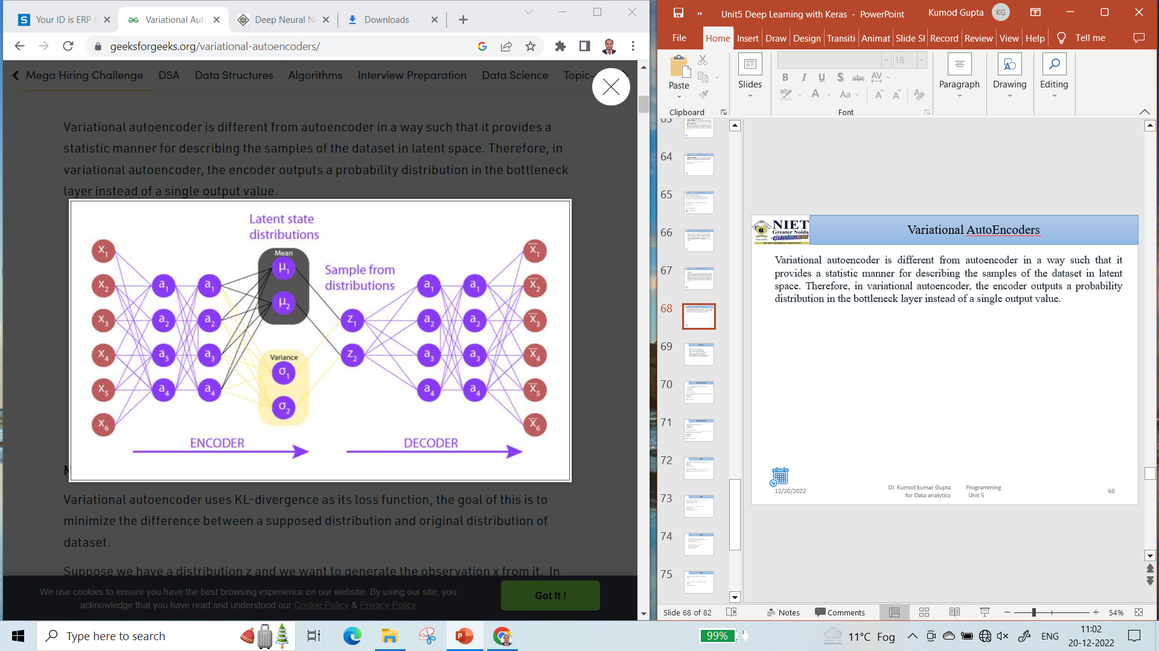
Variational AutoEncoders

Slide 45
Variational AutoEncoders
Mathematically, in VAEs, researchers express the regularization by incorporating a Kullback-Leibler (KL) divergence term into the loss function.
The encoder network generates parameters (e.g., mean and log-variance) of a Gaussian distribution for sampling the latent code. The loss function of a VAE includes the calculation of the KL divergence between the distribution of the learned latent variables and a prior distribution, normal distribution.
Researchers incorporate the KL divergence term to encourage the latent variables to possess distributions similar to the prior distribution. here is the formula for KL divergence:
KL(q(z∣x)∣∣p(z)) = E[log q(z∣x) − log p(z)]
In summary, the regularization incorporated in VAEs plays a crucial role in enhancing the model’s capacity to generate fresh data samples while mitigating the risk of overfitting the training data

Slide 46
Generative Adversarial Network (GAN)
GANs is an approach for generative modeling using deep learning methods.
Generative modeling is an unsupervised learning approach that involves automatically discovering and learning patterns in input data such that the model can be used to generate new examples from the original dataset.
It was developed and introduced by Ian J. Goodfellow in 2014.
GANs are basically made up of a system of two competing neural network models which compete with each other and are able to analyze, capture and copy the variations within a dataset.

Slide 47
Generative Adversarial Network (GAN)
Why were GANs developed in the first place? It has been noticed most of the mainstream neural networks can be easily fooled into misclassifying things by adding only a small amount of noise into the original data.
Surprisingly, the model after adding noise has higher confidence in the wrong prediction than when it predicted correctly.
The reason for such adversary is that most machine learning models learn from a limited amount of data, which is a huge drawback, as it is prone to overfitting.

Slide 48
Generative Adversarial Network (GAN)
How does GANs work?
Generative Adversarial Networks (GANs) can be broken down into three parts:
Generative: which describes how data is generated in terms of a probabilistic model.
Adversarial: The training of a model is done in an adversarial setting.
.
Networks: Use deep neural networks as the artificial intelligence (AI) algorithms for training purpose.

Slide 49
Generative Adversarial Network (GAN)
In GANs, there is a generator and a discriminator.
The Generator generates fake samples of data(be it an image, audio, etc.) and tries to fool the Discriminator.
The Discriminator, on the other hand, tries to distinguish between the real and fake samples.
The Generator and the Discriminator are both Neural Networks and they both run in competition with each other in the training phase.
The steps are repeated several times and in this, the Generator and Discriminator get better and better in their respective jobs after each repetition.

Slide 50
Generative Adversarial Network (GAN)
Here, the generative model captures the distribution of data and is trained in such a manner that it tries to maximize the probability of the Discriminator in making a mistake.
The Discriminator, on the other hand, is based on a model that estimates the probability that the sample that it got is received from the training data and not from the Generator.
The GANs are formulated as a minimax game, where the Discriminator is trying to minimize its reward V(D, G) and the Generator is trying to minimize the Discriminator’s reward or in other words, maximize its loss.
It can be mathematically described by the formula below:

Slide 51
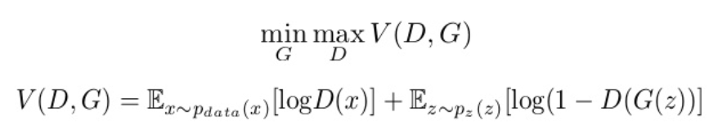
Generative Adversarial Network (GAN)
G = Generator D = Discriminator Pdata(x) = distribution of real data P(z) = distribution of generator x = sample from Pdata(x) z = sample from P(z) D(x) = Discriminator network G(z) = Generator network

Slide 52
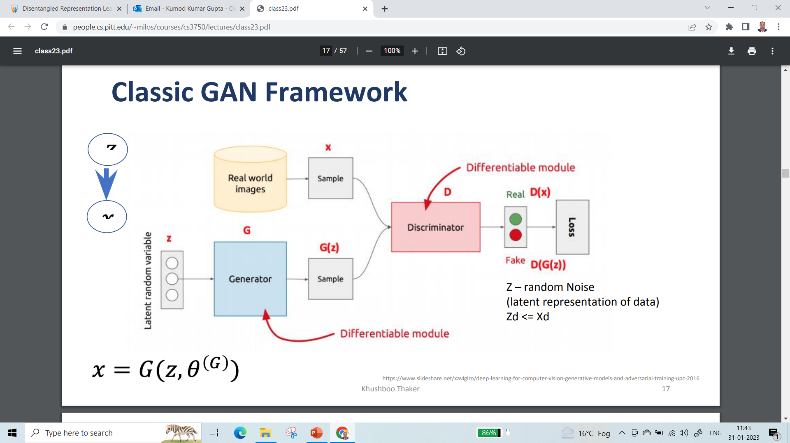
Generative Adversarial Network (GAN)

Slide 53
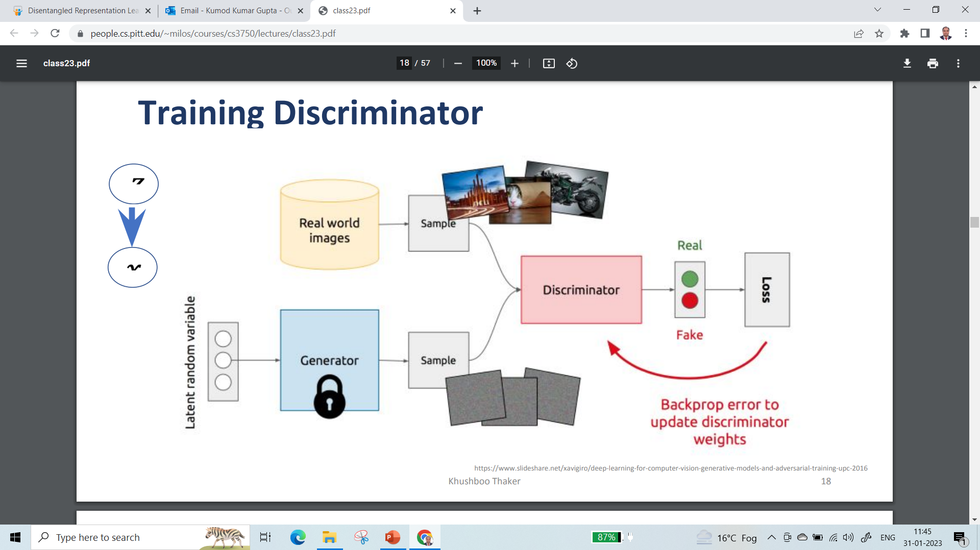
Generative Adversarial Network (GAN)

Slide 54
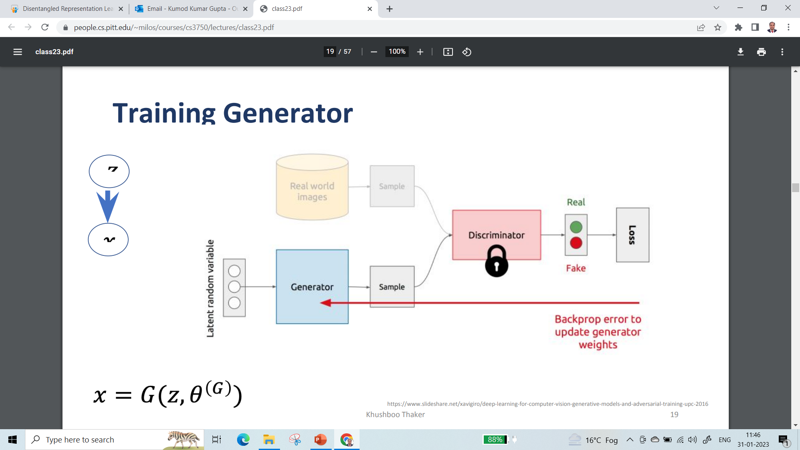
Generative Adversarial Network (GAN)

Slide 55
Generative Adversarial Network (GAN)
So, basically, training a GAN has two parts:
Part 1: The Discriminator is trained while the Generator is idle. In this phase, the network is only forward propagated, and no back-propagation is done. The Discriminator is trained on real data for n epochs and see if it can correctly predict them as real.
Also, in this phase, the Discriminator is also trained on the fake generated data from the Generator and see if it can correctly predict them as fake.
Part 2: The Generator is trained while the Discriminator is idle. After the Discriminator is trained by the generated fake data of the Generator, we can get its predictions and use the results for training the Generator and get better from the previous state to try and fool the Discriminator.
The above method is repeated for a few epochs and then manually check the fake data if it seems genuine. If it seems acceptable, then the training is stopped, otherwise, its allowed to continue for few more epochs.

Slide 56
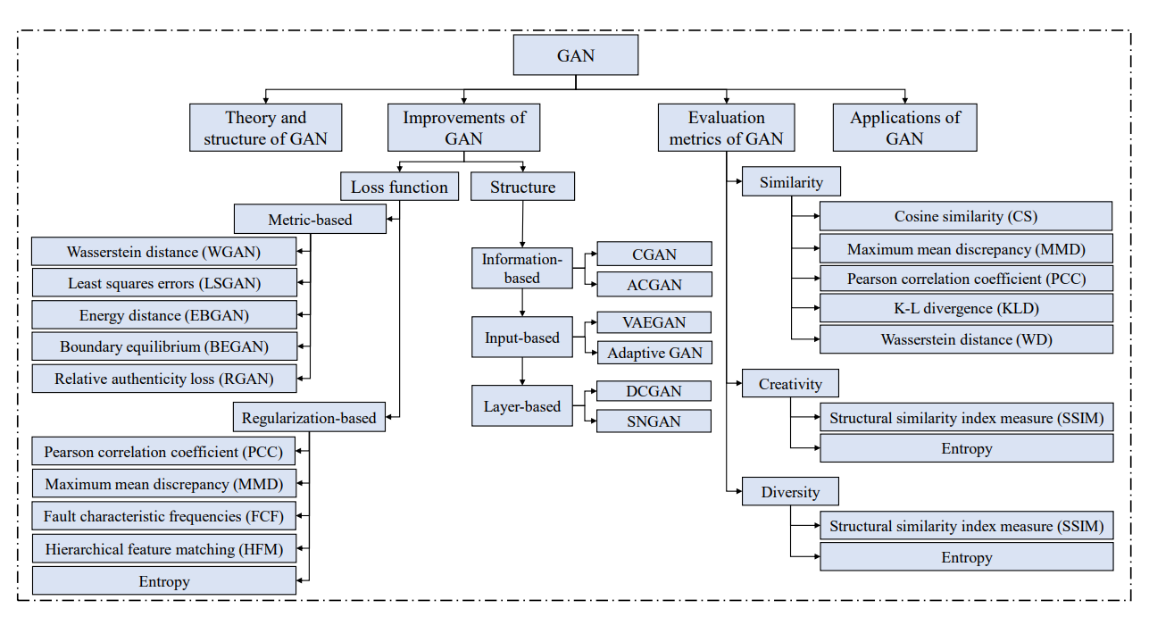
Improved Adversarial Network

Slide 57
Improved GAN
Different types of GANs: GANs are now a very active topic of research and there have been many different types of GAN implementation. Some of the important ones that are actively being used currently are described below:
Vanilla GAN: This is the simplest type GAN. Here, the Generator and the Discriminator are simple multi-layer perceptron. In vanilla GAN, the algorithm is really simple, it tries to optimize the mathematical equation using stochastic gradient descent.
Conditional GAN (CGAN): CGAN can be described as a deep learning method in which some conditional parameters are put into place. In CGAN, an additional parameter ‘y’ is added to the Generator for generating the corresponding data. Labels are also put into the input to the Discriminator in order for the Discriminator to help distinguish the real data from the fake generated data.

Slide 58
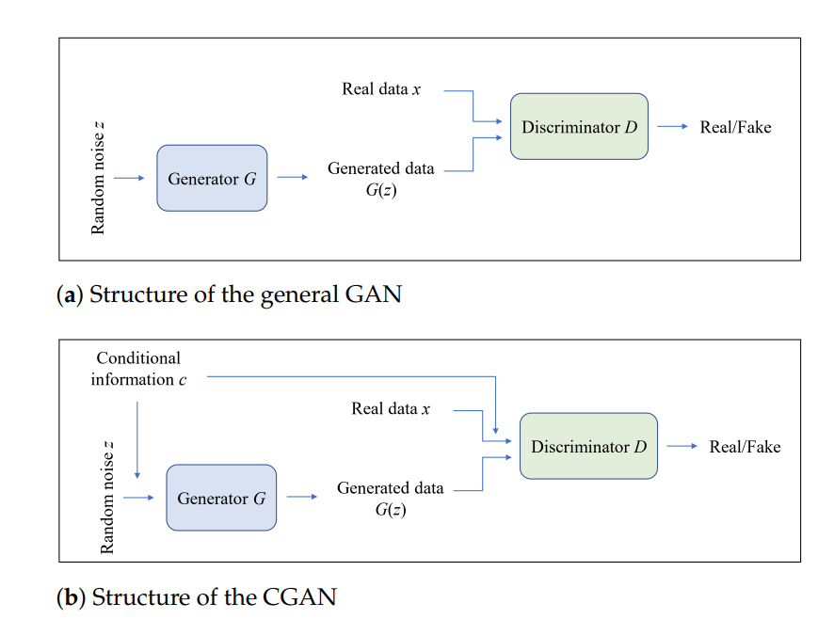
Improved GAN

Slide 59
Improved GAN
3. Deep Convolutional GAN (DCGAN): DCGAN is one of the most popular also the most successful implementation of GAN. It is composed of ConvNets in place of multi-layer perceptrons. The ConvNets are implemented without max pooling, which is in fact replaced by convolutional stride. Also, the layers are not fully connected.
4. Laplacian Pyramid GAN (LAPGAN): The Laplacian pyramid is a linear invertible image representation consisting of a set of band-pass images, spaced an octave apart, plus a low-frequency residual.
This approach uses multiple numbers of Generator and Discriminator networks and different levels of the Laplacian Pyramid. This approach is mainly used because it produces very high-quality images.
The image is down-sampled at first at each layer of the pyramid and then it is again up-scaled at each layer in a backward pass where the image acquires some noise from the Conditional GAN at these layers until it reaches its original size.

Slide 60
Generative Adversarial Network (GAN)
5. Super Resolution GAN (SRGAN): SRGAN as the name suggests is a way of designing a GAN in which a deep neural network is used along with an adversarial network in order to produce higher resolution images.
This type of GAN is particularly useful in optimally up-scaling native low-resolution images to enhance its details minimizing errors while doing so.

Slide 61
Advanced Generative Adversarial Network
Deep Convolutional GAN (DCGAN) was proposed by a researcher from MIT and Facebook AI research.
It is widely used in many convolution-based generation-based techniques.
DCGANs are introduced to reduce the problem of mode collapse. Mode collapse occurs when the generator got biased towards a few outputs and can’t able to produce outputs of every variation from the dataset.
For example- take the case of mnist digits dataset (digits from 0 to 9) , we want the generator should generate all type of digits but sometimes our generator got biased towards two to three digits and produce them only. Because of that the discriminator also got optimized towards that particular digits only, and this state is known as mode collapse. But this problem can be overcome by using DCGANs.

Slide 62
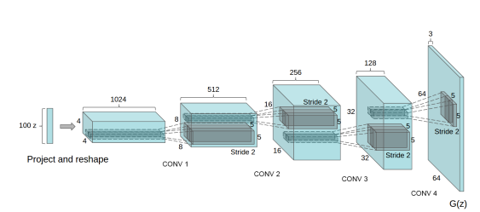
Generative Adversarial Network (GAN)

Slide 63
Generative Adversarial Network (GAN)
The generator of the DCGAN architecture takes 100 uniform generated values using normal distribution as an input.
First, it changes the dimension to 4x4x1024 and performed a fractionally stridden convolution 4 times with a stride of 1/2 (this means every time when applied, it doubles the image dimension while reducing the number of output channels).
The generated output has dimensions of (64, 64, 3). There are some architectural changes proposed in the generator such as the removal of all fully connected layers, and the use of Batch Normalization which helps in stabilizing training.

Slide 64
Generative Adversarial Network (GAN)
ReLU activation function s used in all layers of the generator, except for the output layers.
We will be implementing generator with similar guidelines but not completely the same architecture.
The role of the discriminator here is to determine that the image comes from either a real dataset or a generator. The discriminator can be simply designed similar to a convolution neural network that performs an image classification task.
Instead of fully connected layers, they used only strided-convolutions with LeakyReLU as an activation function, the input of the generator is a single image from the dataset or generated image and the output is a score that determines whether the image is real or generated

Slide 65
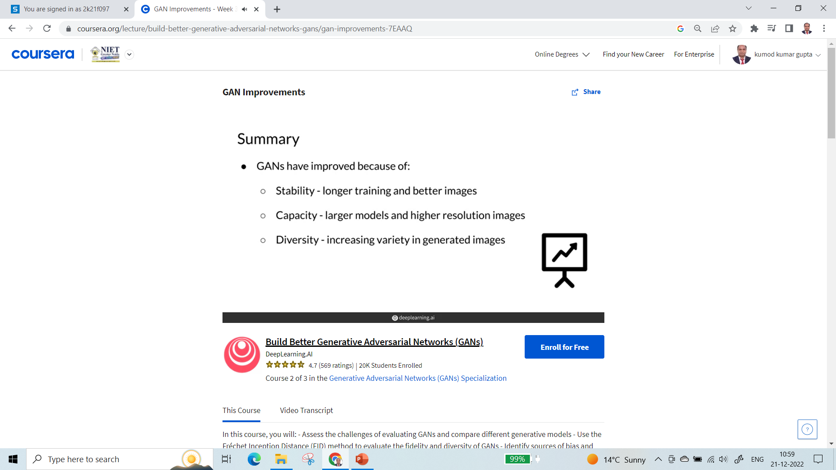
Improved Generative Adversarial Network (GAN)

Slide 66
Disentangled Representation GANs
Disentangled Representation Learning
Disentangle means Exacting from something
Disentangled representation learning is a concept in machine learning that refers to the process of learning a representation of data where the individual factors of variation in the data are captured by separate, distinct elements of the representation.
In simpler terms, it's about breaking down complex data into its underlying factors in a way that each factor is represented independently of the others.
What is a Representation?
In machine learning, a representation is a set of features or attributes that captures some meaningful structure of the data. For example, in an image of a face, the representation might include features that capture the color of the eyes, the shape of the nose, or the presence of a smile. These features are what algorithms use to understand, classify, or make decisions about the data.

Slide 67
Disentangled Representation GANs
The Need for Disentanglement
Real-world data is often complex and high-dimensional, with many underlying factors that can vary independently. For instance, in images of cars, factors such as the color, make, model, and angle of the photo can all change independently.
Traditional machine learning models might struggle to isolate these factors if they are entangled in the representation, leading to less effective learning and generalization.
Disentangled representations aim to separate these factors, making it easier for models to understand the structure of the data and how different factors contribute to it.
This can lead to more interpretable models, better generalization to new scenarios, and improved performance in tasks such as transfer learning, where a model trained on one task is adapted to another.

Slide 68
Disentangled Representation GANs
Approaches to Disentangled Representation Learning
GANs can also be used for disentangled representation learning by modifying the training process to encourage the generator to learn separate factors of variation. This can be achieved by providing additional information during training or by structuring the generator's input space in a way that different parts correspond to different factors.
Challenges in Disentangled Representation Learning
One major difficulty is the lack of a clear, agreed-upon definition of what it means for a representation to be disentangled. Different researchers might have different criteria for disentanglement, making it hard to compare methods or measure progress.
Another challenge is that disentanglement often requires more than just unsupervised learning from data. It might require some form of supervision or inductive biases built into the model to guide the learning process. This can complicate the training process and require additional data or domain knowledge

Slide 69
Disentangled Representation GANs
Applications of Disentangled Representation Learning
In computer vision, they can improve the performance of models on tasks like facial expression recognition by separating factors such as identity and emotion.
In robotics, disentangled representations can help robots understand and manipulate objects by isolating properties like shape and color.
In natural language processing, disentangled representations can help models capture the meaning of words independently of their context, leading to better performance on tasks like machine translation or sentiment analysis.
More broadly, disentangled representations can contribute to the interpretability of machine learning models, making it easier for humans to understand and trust their decisions.

Slide 70
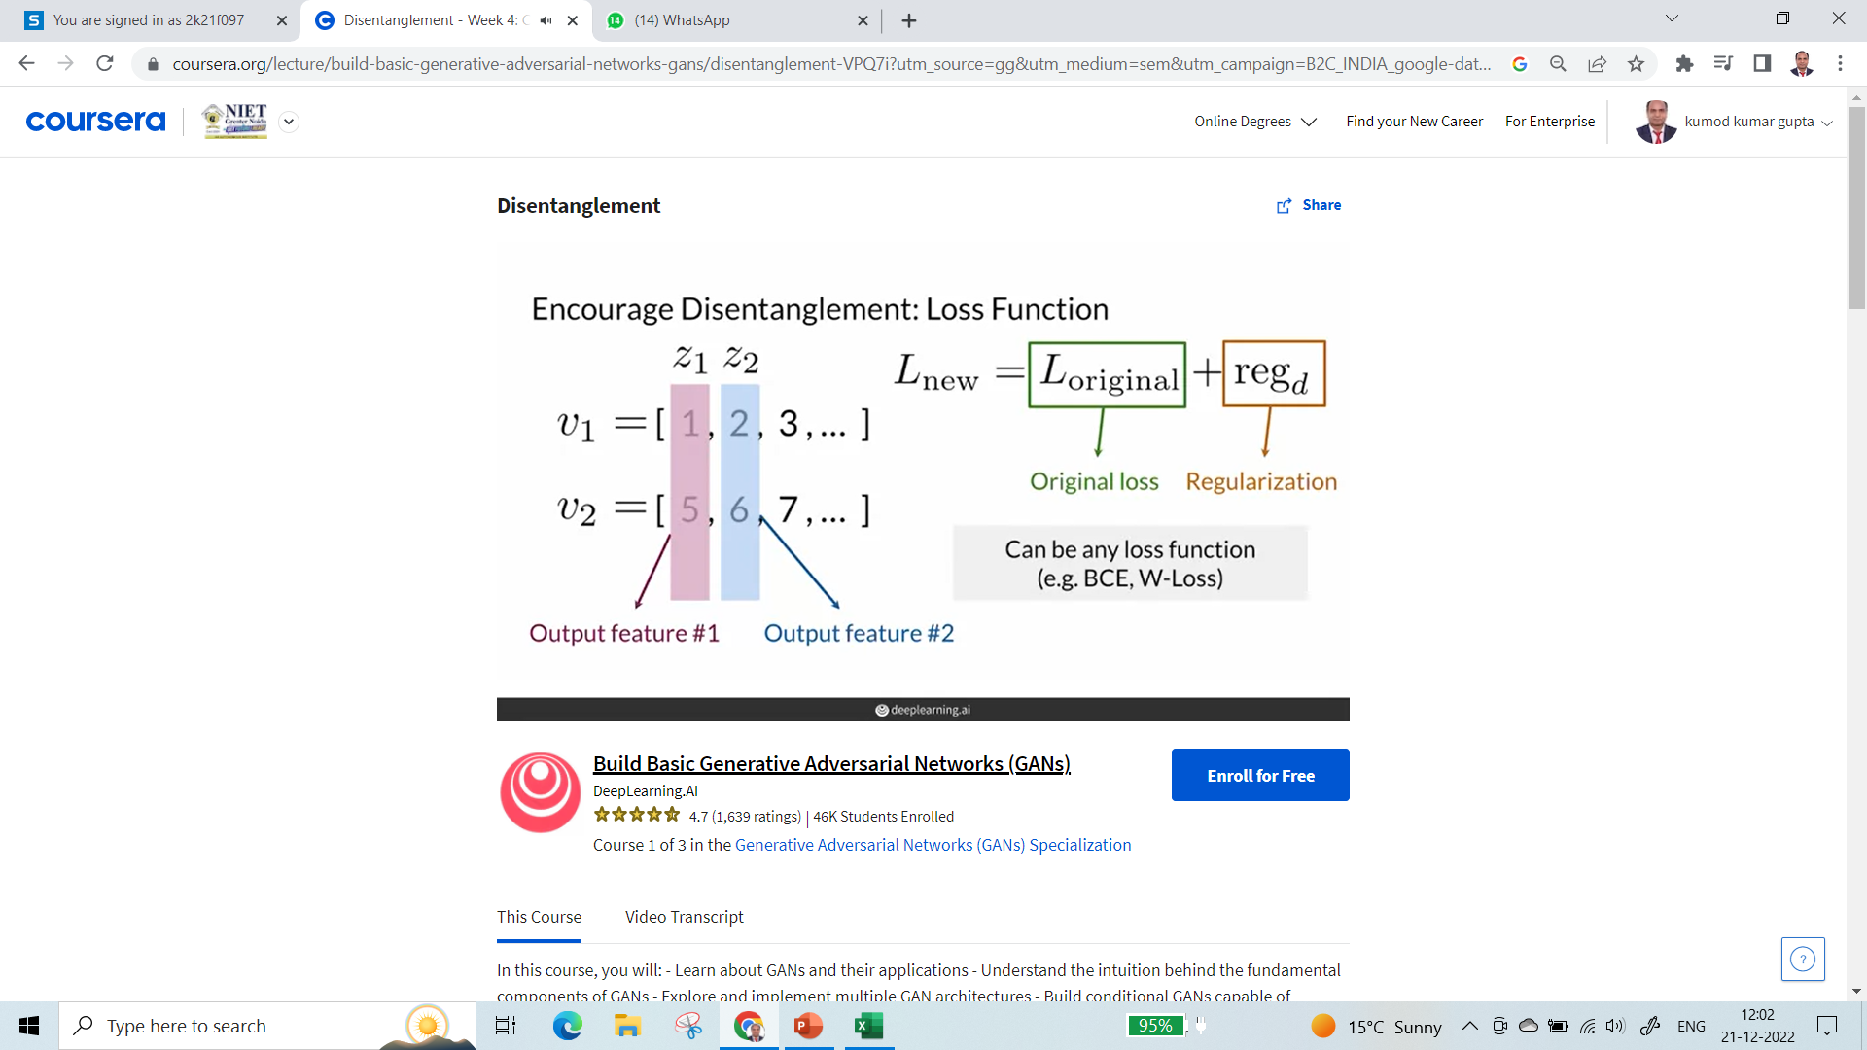
Disentangled Representation GANs

Slide 71
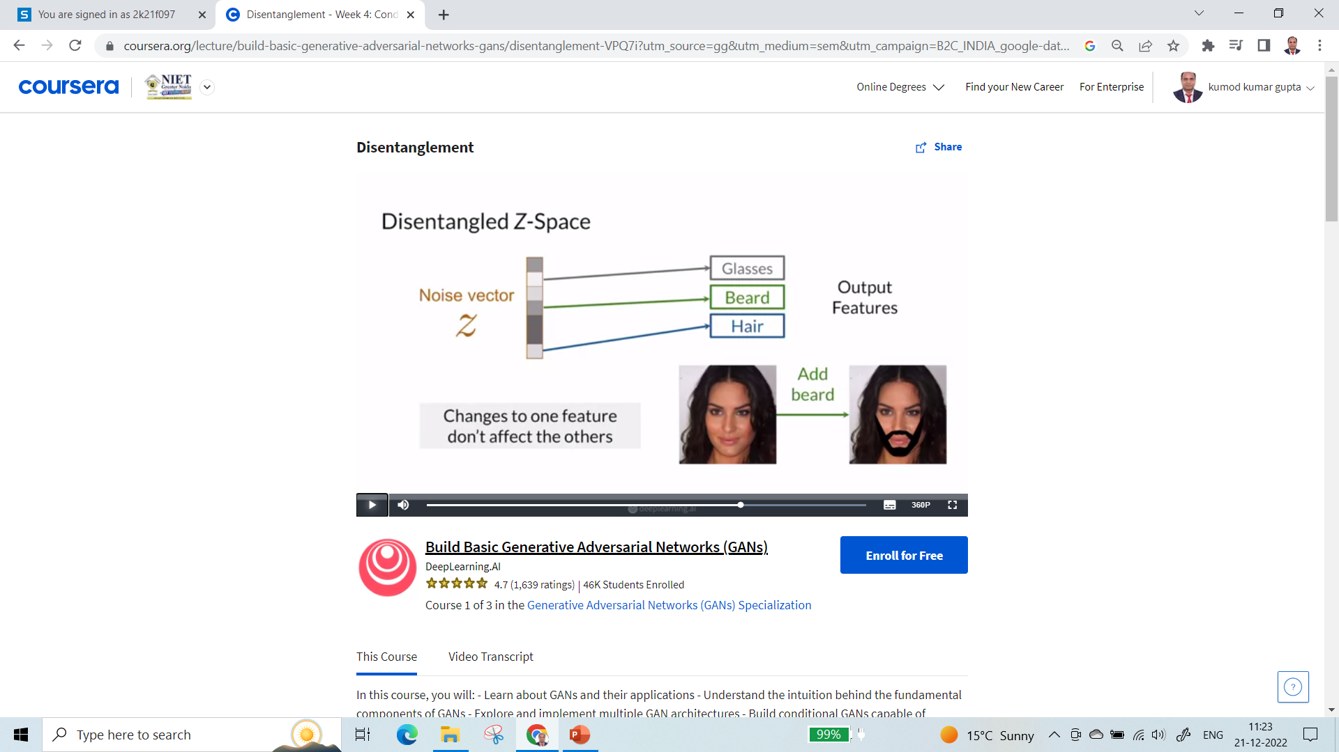
Disentangled Representation GANs

Slide 72
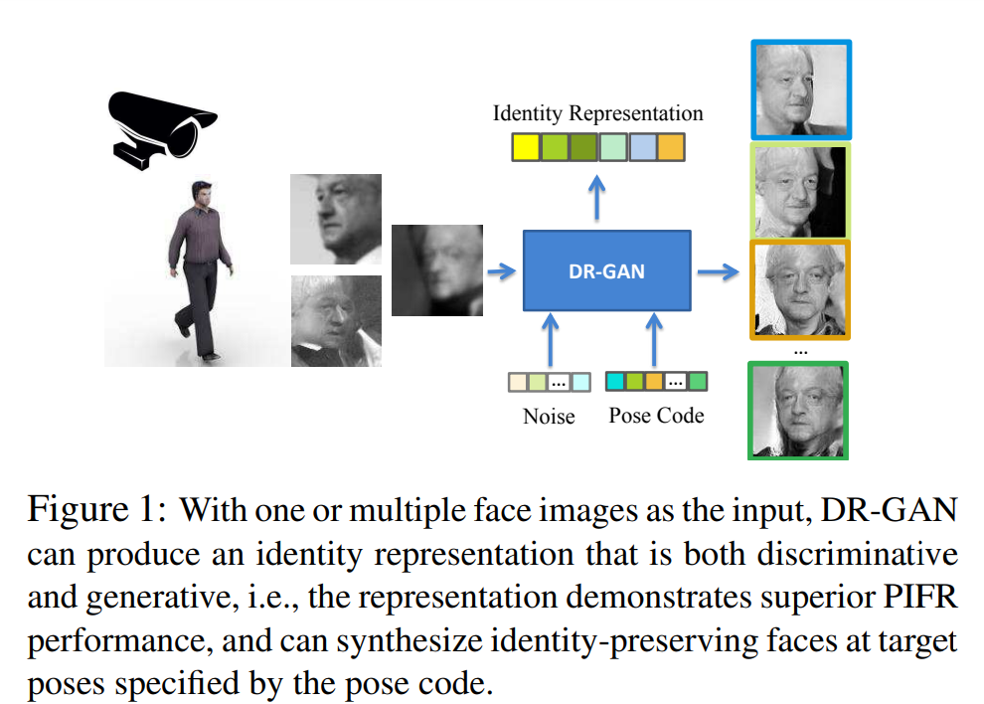
Disentangled Representation GANs

Slide 73
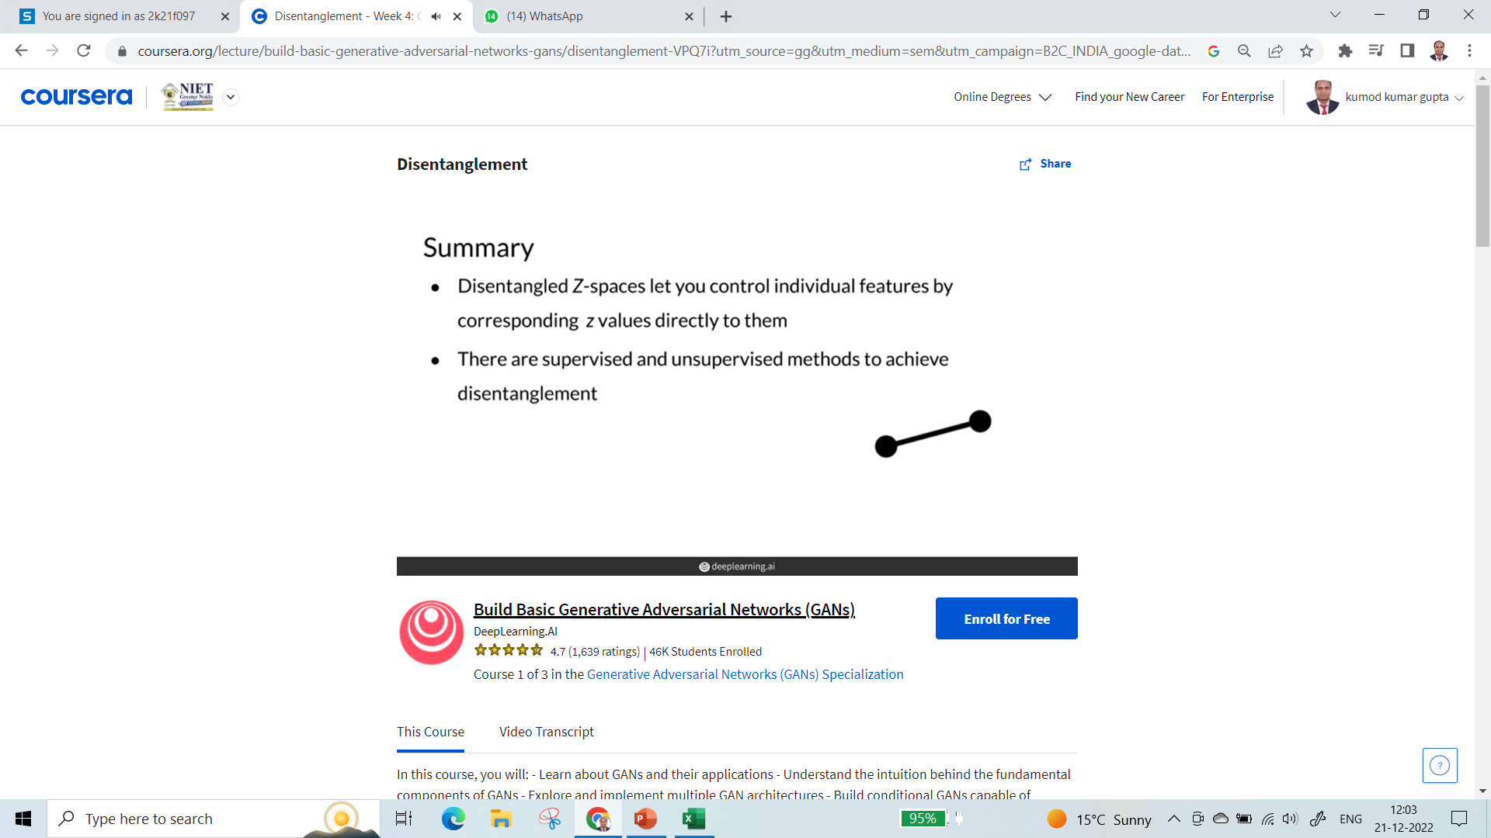
Disentangled Representation GANs

Slide 74
Deep reinforcement Learning
Deep reinforcement learning (deep RL) is a subfield of machine learning that combines reinforcement learning (RL) and deep learning. RL considers the problem of a computational agent learning to make decisions by trial and error.
Deep RL incorporates deep learning into the solution, allowing agents to make decisions from unstructured input data without manual engineering of the state space.
Deep RL algorithms are able to take in very large inputs (e.g. every pixel rendered to the screen in a video game) and decide what actions to perform to optimize an objective (e.g. maximizing the game score).
Deep reinforcement learning has been used for a diverse set of applications including but not limited to robotics, video games, natural language processing, computer vision, education, transportation, finance and healthcare.

Slide 75
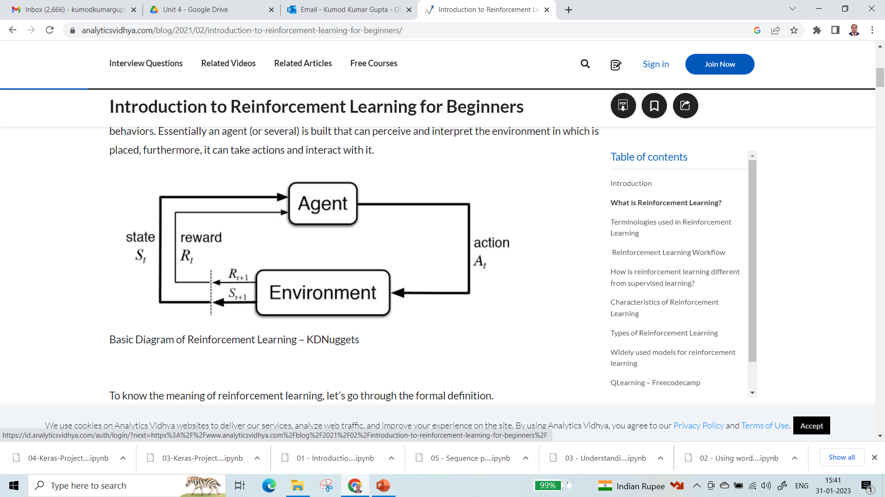
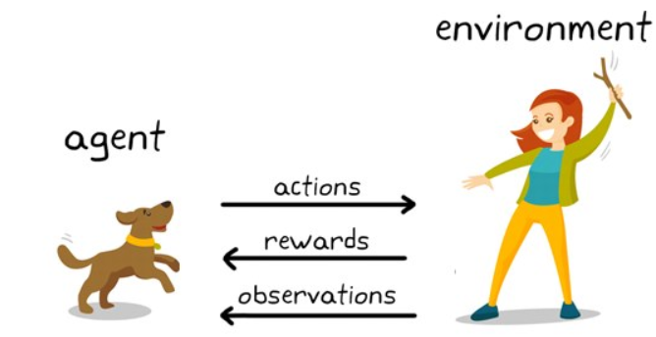
Deep reinforcement Learning
Reinforcement Learning

Slide 76
Applications Deep reinforcement Learning
Applications of deep Reinforcement Learning
Finally, let’s have a look at some of the real-world applications of Reinforcement Learning.
Industrial manufacturing
Deep Reinforcement Learning is very commonly applied in Robotics.
The actions that the robot has to take are inherently sequential. Agents learn to interact with dynamic changing environments and thus find applications in industrial automation and manufacturing.
Labor expenses, product faults and unexpected downtime are being reduced with significant improvement in transition times and production speed.
Self-driving cars
Machine Learning technologies power self-driving cars.
Autonomous vehicle used large amounts of visual data and leveraged image processing capabilities in cohesion with Neural Network architecture.

Slide 77
Applications Deep reinforcement Learning
Trading and Finance
We have seen how supervised learning and time-series analysis helps in prediction of the stock market. But none helps us in making decisions of what to do in a particular situation. An RL agent can select whether to hold, buy, or sell a share. To guarantee that the RL model is working optimally, it is assessed using market benchmark standards.
Natural Language Processing
Reinforced Learning is expanding in wings and has conquered NLP too. Different NLP tasks like question-answering, summarization, chatbot implementation can be done by a Reinforcement Learning agent.
Virtual Bots are trained to mimic conversations. Sequences with crucial conversation properties including coherence, informativity, and simplicity of response are rewarded using policy gradient approaches.
Healthcare
Reinforced Learning in healthcare is an area of continuous research. Bots equipped with biological information are extensively trained to perform surgeries that require precision. RL bots help in better diagnosis of diseases and predict the onset of disease if the treatment is delayed and so on.

Slide 78
Applications Deep reinforcement Learning
Deep Reinforcement Learning: Key Takeaways
Here’s a short recap of everything we’ve learnt about Deep Reinforcement Learning so far.
The essence of Reinforced Learning is to enforce behavior based on the actions performed by the agent. The agent is rewarded if the action positively affects the overall goal.
The basic aim of Reinforcement Learning is reward maximization. The agent is trained to take the best action to maximize the overall reward.
RL agents work by using the already known exploited information or exploring unknown information about an environment.
Policy refers to the strategy the agent follows to determine the next action based on current state.
In Contrast to Reward, which implies a short-term gain, Value refers to the long-term return with discount.
The heart of Reinforcement Learning is the mathematical paradigm Markov Decision Process. It is a way of defining the probability of transitioning from one state to another.

Slide 79
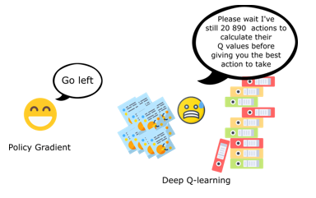
Policy Gradient Methods

Slide 80
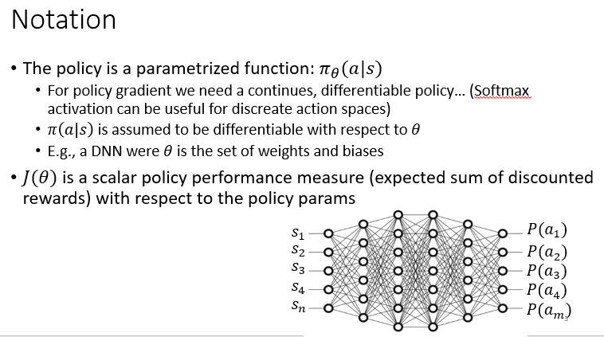
Policy Gradient Methods

Slide 81
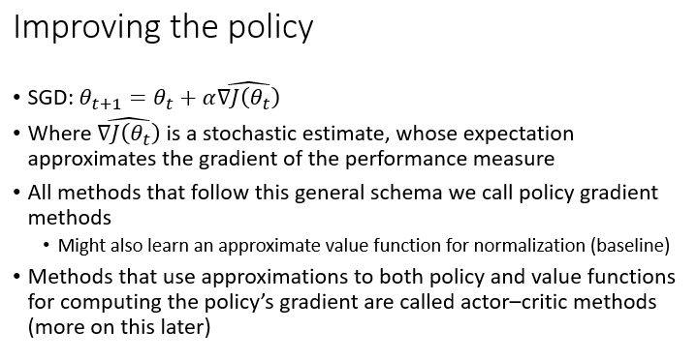
Policy Gradient Methods

Slide 82
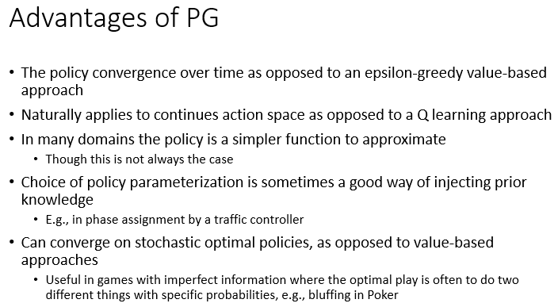
Policy Gradient Methods

Slide 83
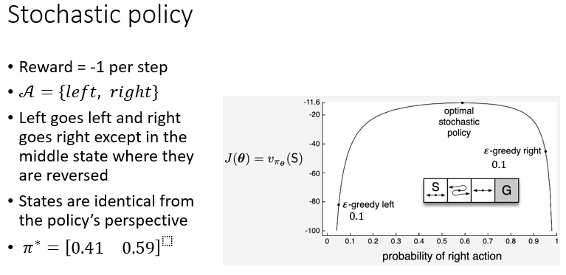
Policy Gradient Methods

Slide 84
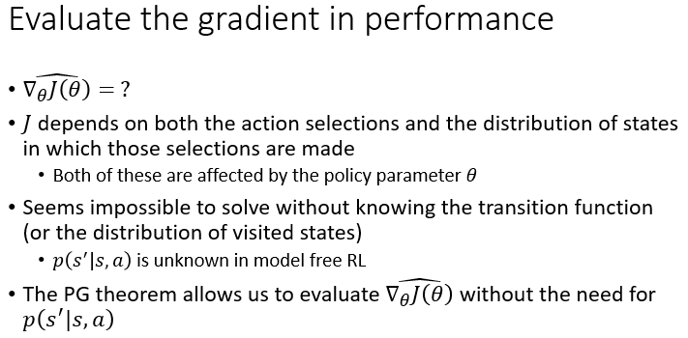
Policy Gradient Methods

Slide 85
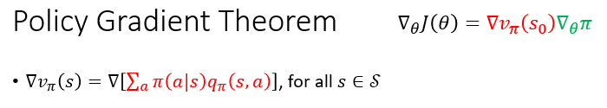
Policy Gradient Methods

Slide 86
Policy Gradient Methods
Thank you

